Slide 1

Anomaly detection in vessel traffic

Slide 2
Quick Recap
Neural network predictions
Statistical approach

Slide 3
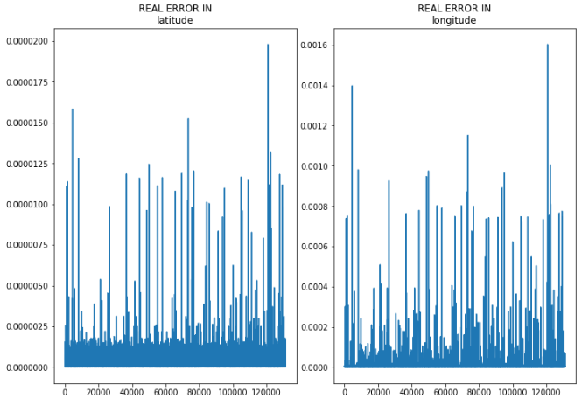
Neural network predictions
Best result so far:
1 hidden layer with 1000 nodes
RMSE 0.0050
Real error:
Latitude: ~0.0000025 (~0.25 meter)
Longitude: ~0.0003 (~25 meter)

Slide 4

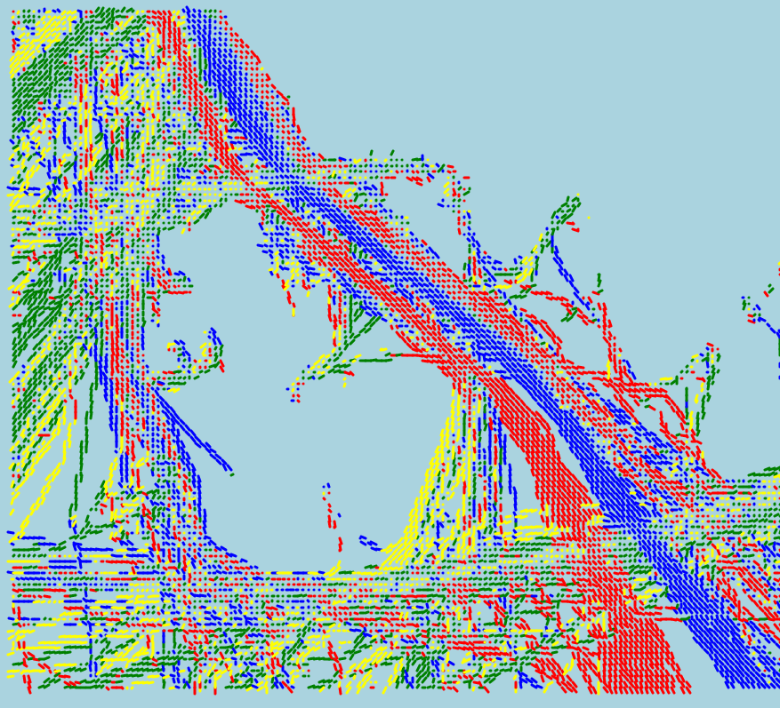
Directional map
Map common direction
Check if new point matches direction
Mark anomalous if too far off

Slide 5
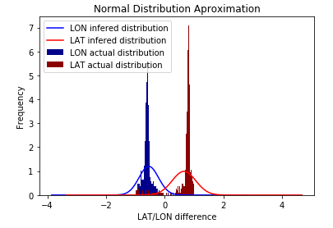
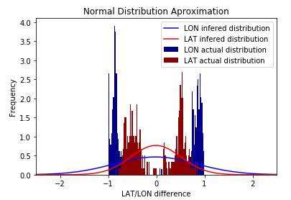
Directional map
LAT/LON rounded to 3 decimals
Some points can have more than 1 direction
round LAT/LON differently
different distribution algorithm

Slide 6
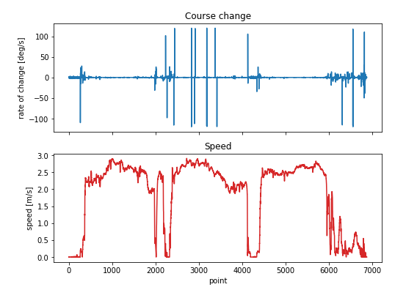
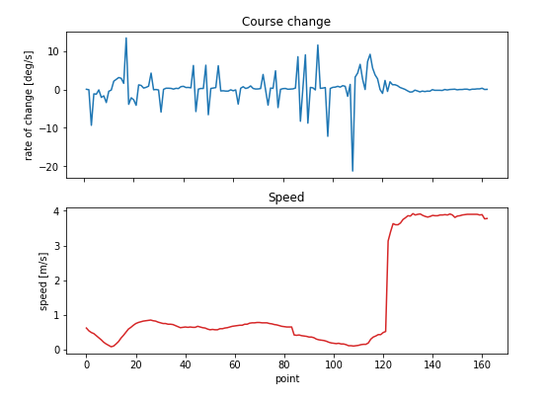
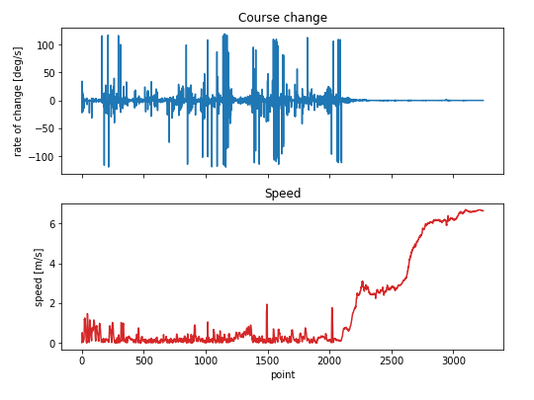
Angular velocity
Course change compared with speed
High speed + high angular velocity = anomaly

Slide 7
This week
Continue both approaches
Start working on prototype

Slide 8
Neural network - next step
Start moving focus to classification
Change routes to make our own anomalies

Slide 9
Statistical approach - next steps
Improve directional map
Angular velocity

Slide 10
Prototype
Show a map of the harbor with ships
Slide through time to visualize
Show normal/anomalous behavior when it occurs

Slide 11
Questions?

